Slide 1

Java 8 Date & Time API
Manipulating Date & Time Using All New Date API

Slide 2
Introduction
Java SE 8 will ship with a new date and time API in java.time that offers greatly improved safety and functionality for developers.
The new API models the domain well, with a good selection of classes for modelling a wide variety of developer use cases.
The existing classes (such as java.util.Date and SimpleDateFormatter) aren’t thread-safe, leading to potential concurrency issues.
Some of the date and time classes also exhibit quite poor API design. For example, years in java.util.Date start at 1900, months start at 1, and days start at 0—not very intuitive.

Slide 3
LocalDate & LocalTime class
The first classes you will probably encounter when using the new API are LocalDate and LocalTime.
They are local in the sense that they represent date and time from the context of the observer,
such as a calendar on a desk or a clock on your wall.
There is also a composite class called LocalDateTime, which is a pairing of LocalDate and LocalTime.
LocalDate, LocalTime, and LocaleDateTime are the most commonly used classes in the new Date API. These classes provide information independent of time zone i.e. we need not worry about the time zone.

Slide 4
Working with Date Class
LocalDate represents date without time zone in ISO format.
This is one of the most commonly used classes in the new Date API. An instance of this class is immutable and represents date without information of the time and time zone.
LocalDate provides multiple utility methods to create an instance of this class.
We can use of static factory method of the LocalDate class to create an instance of this class.
now()
of()
We can use LocalDate.now() factory method to get current date based on the system clock.
We can use LocalDate.of(2018,4,11) factory method to get customized date.

Slide 5
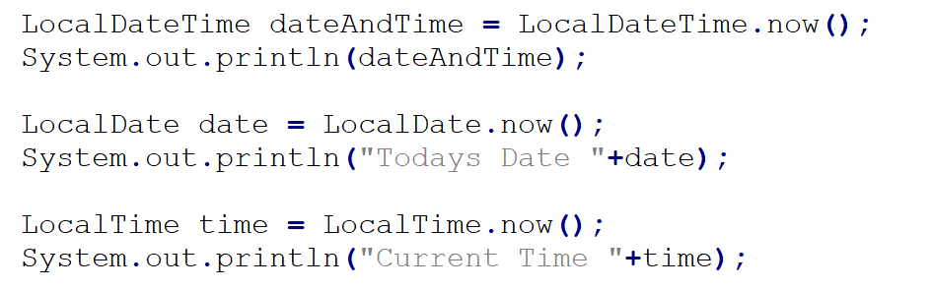
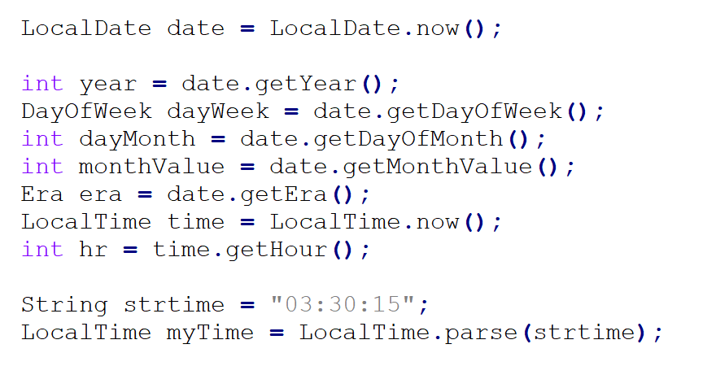
Current Date & Time

Slide 6
Specific Date & Time

Slide 7
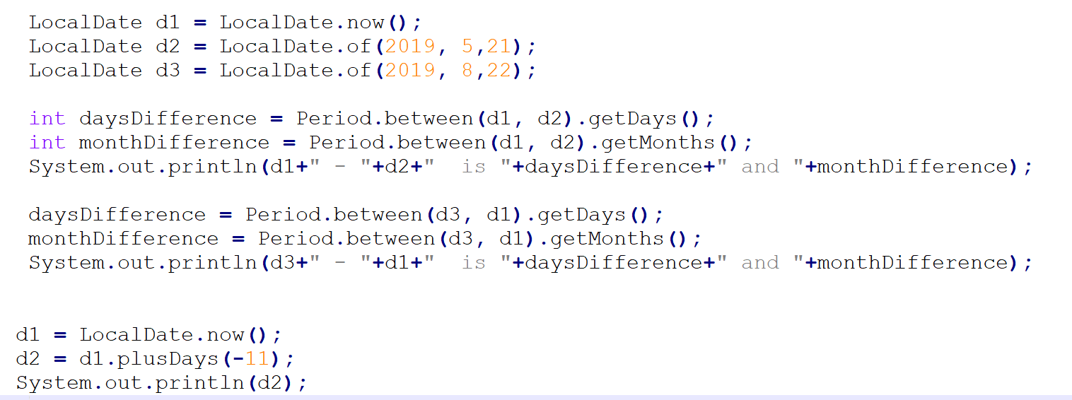
Period Class

Slide 8
END of Date API

